Slide 1
This template includes
Cover slide and divider slide options Mix and match the cover slides with the divider slides. You can use any combination of block composition backgrounds.
Content slides Use these empty layouts to build your deck. A sample of the options are shown. You can add or change layouts on the Home tab.
Examples of application Refer to these slides for examples of how to use the layouts.
Reference Instructions for formatting your tables; more resources for PowerPoint.

Slide 2
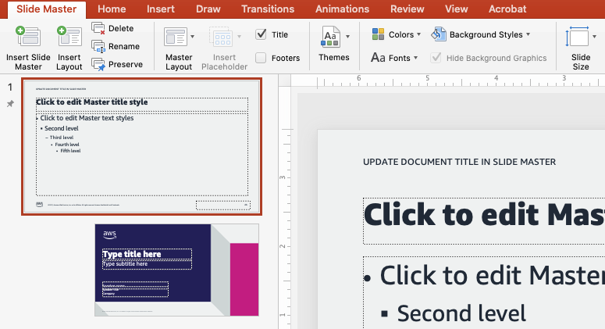
Editing the master slide
Go to View > Slide Master (button on ribbon)
The master slide is the very first one in the Slide Master view (below.)
You can edit or delete the document title and page numbers here. All changes will flow down to the child page layouts.
If you don’t want the document title on every slide, delete from the slide master

Slide 3
Some caveats
This template is not intended for AWS Global Events Contact the Events team for assistance: Global Events Design wiki
This template is not intended for broadcast Presentations that will be broadcast and seen on a variety of monitors must consider the title safe area
For more information: Video guidelines on the Brand portal

Slide 4
Curantis Data Modernization with HealthLake
Unifying Distributed Data
Benjamen Pyle
CTO
Curantis Solutions

Slide 5
Agenda
Introduction – Who am I and who is Curantis Solutions
Building an EHR for Hospice and Palliative Care
Challenges in Healthcare Data
Enter Gain Insights
Unifying our data
Design
Approach
Use Cases
Where We are Headed

Slide 6
Who am I
Developer and architect with over 25 years experience building customer-based applications with a variety of technologies and deployment models
10 + years leading software development teams in building products related to Healthcare specifically in health and wellness, physician preference, performance and analytics, remote patient monitoring and electronic health records
8 + years building in AWS
AWS Community Builder specializing in Serverless Builds and Deployments
CTO for Curantis Solutions
@benjamenpyle

Slide 7
Who is Curantis Solutions
Software company building an EHR for Hospice and Palliative Care founded in 2015
Market is customer agencies who take care of Hospice and Palliative care patients with multiple user personas
Clinicians such as Doctors and Nurses
Aides, Social Workers and Chaplains
Back-office and administrators
Billers and claims coders
100% SaaS based with an AWS Serverless and Event-Driven Architecture
Believes that care delivery can be transformed with good and unobtrusive technology that gives caregivers just enough software without impeding the care that is being delivered

Slide 8
Building an EHR for Hospice and Palliative Care
Simplified Architecture
Decoupled and Highly Distributed
Software Architecture is Serverless and Event-Driven
Each feature owns its code, runtime, infrastructure and most importantly its Data
Features communicate over Events (Pub/Sub) and APIs, not by sharing Databases
Data is stored in the format of the EHR, not in a format built for Healthcare exchange. Think JSON not FHIR

Slide 9
Challenges in Healthcare Data
Contract and Content of data varies
Ownership and governance is not consistent
Data changes are in-frequent, late or can be bursty
Is unrefined and noisy.
Format
Siloed
Speed
Resources

Slide 10
Gain Insights
Customer Engagement Program designed to delivery quicker customer outcomes
Program focuses on working backwards from Business Outcomes into a possible Technical Solution and Architecture
Executed at multiple levels of the organization to gain buy-in and give the best chance for success as you transition from design into execution
Curantis leveraged Gain Insights over a two-month period in order to accelerate our Modernization Efforts
We focused on unifying our data so that we could accomplish the following
Achieve a single source of truth our EHR Data
Provide a common, content and contract standards API for our customers and internal developers in an effort to achieve a higher level of Interoperability
Deliver insights to our customers faster via Analytics, Reporting and Predications

Slide 11
Unifying Our Data
HealthLake as our Center
AWS HealthLake as the center
Sources can be internal or external
Data is transformed in near real-time
Ultimately is formatted in FHIR v4 format
Consumers are internal and external

Slide 12
Unifying Our Data

Slide 13
Unifying Our Data
Innovate
Opensource Languages and Frameworks
AWS Serverless Building Blocks
Be Intentional about Team Choices
Start with standardizing AWS Serverless Building Blocks
Standardize on common languages and frameworks so that code and patterns look the same
Innovate where the logic matters in providing value and differentiation to our customers

Slide 14
Use Cases
Interoperability, Analytics, Predictions
Clinical Metrics
Operational Metrics
Internal and External Interoperability
Patient and workflow enhancements via predictive analytics
Improving Clinicians visibility into patient decline and outcomes
Provide real time insights for operators that run their agencies from a staffing and billing/claims perspective
Extend our core system internally and externally via FHIR standards, Event-Driven approach and public APIs
Enhance patient workflow and plan of care decisions by leveraging Predictive Analytics

Slide 15
Where We are Headed
Built for growth and preparing for an aging population in addition to a modern caregiver population
Analytics
Embedding Insights into our EHR closer to point of care
Data
Adding more sources externally to expand our dataset and patient’s continuum of care
Partnering
Partnering with new providers in order to improve patient care in different care settings

Slide 17
Presentation slides
See the template in action
Ana Carolina Silva (she/her)
Senior Solutions Architect
AWS

Slide 18
Agenda
Where we were
Our roadmap to the solution
Key steps we took and decisions we made
How we solved the problem
Where we are today

Slide 19
Good presentations
Are customer-focused
Are true to the abstract
Tell a story
Provide clear takeaways
Have simple visuals and one message per slide

Slide 20
Tips
A main point
Use images
Highlight
Only essentials
Have one main point for your presentation and one supporting point for each slide
Use images and clear data to explain your message
Highlight the most important content in the presentation and on each slide
Remove anything that isn’t essential to the main point

Slide 21
Every new thing creates two new questions and two new opportunities.
Jeff Bezos
Founder and Executive Chair of Amazon

Slide 22
Enter descriptive titles for charts
To create a new chart, select Insert tab > Chart. Enter your data and adjust the font sizes to the minimum 12 pt. or larger.
Use a bright color to emphasize the most important data. Use subtle colors for other data. Include labels for accessibility.
Charts
Tables
Graphics

Slide 23
Keep charts as simple and clear as possible

Slide 24
Tables
 | Tables | Charts
Main use | Focus on data points | Focus on trends or relationships
Main benefit | Precise | Visual
Second benefit | Drill down on specific data | Simplify complex datasets
Data tips | Table tips | Table formatting | Table don’ts
Be honest and precise | Remove clutter | Left align | Don’t use tiny text
Make a point | Emphasize message | Use consistent sizes | Don’t include it all
Use the right method | Keep it short | Use visible colors | Don’t overcomplicate

Slide 25
Photography
Use it thoughtfully
Photography is an important tool for expressing the AWS brand, our customers and how we enable them to reinvent every day.
Presentation decks are a visual medium intended to provide illustrative support to the message you deliver orally.
Including imagery that supports your points has a more powerful effect on your audience than filling your slides with text.

Slide 27
Only use white logos that AWS has official permission to use
PRO
TIP
Use the Crop tool and grab the round handles (square on Mac) to resize the logos to fit in the placeholders.

Slide 28
Additional resources
Generate QR codes AWS speakers only
Microsoft PowerPoint Help & Learning site Essential basics on using PowerPoint from Microsoft
The World of Presentations podcast Conversations with industry experts about PowerPoint design, mechanics, and presenting
BrightCarbon events Free webinars on PowerPoint design, presenter skills, and more
AWS speakers, more resources are on the wiki

Slide 29
Ana Carolina Silva
@anacarolinasilva

Slide 30
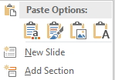
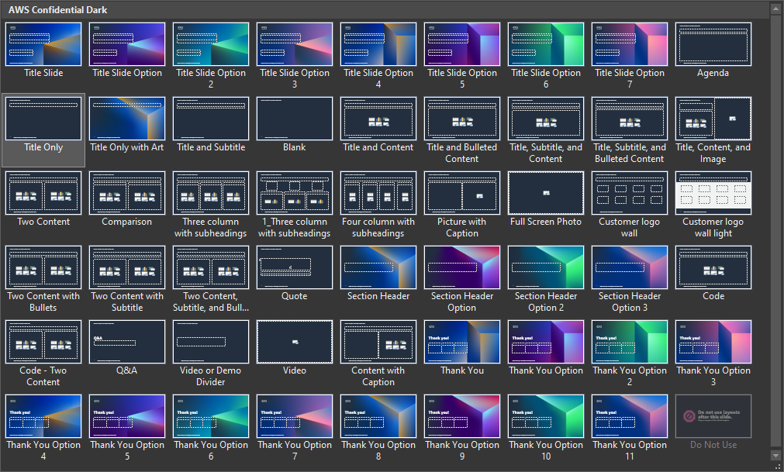
How to add or reuse content
Follow these steps to use this template to create a new slide deck:
Enter your content on the blank slides and delete any unneeded or hidden slides.
If you want to add more slides, on the Insert tab, select the little arrow under New Slide, and then select your desired layout from the options displayed (shown below). Fill out your slide content using the preformatted context placeholders.
End the deck with the Thank You slide and then the Survey Reminder slide layouts.
Follow these steps to apply this template to your existing slide deck:
Select all of the slides in the left-hand pane of this template file and delete them (click on one and press Ctrl + A and then Delete).
Open the deck you’ve already created and select all of the slides in the left-hand pane (Ctrl + A) and copy them (Ctrl + C).
In the template file, right-click in the empty left-hand pane and click Use Destination Theme (use this same method to transfer individual slides).
For each slide in your deck, apply the appropriate layout (Home tab > Slides section > Layout).
Reset the slides (Home tab > Slides section > Reset) and ensure all content is in the appropriate placeholders and resets to the correct location. If needed, copy-paste the content into the correct placeholders.
Save the file and create/revise content as described to the left.
59 available slide layouts

Slide 31
Font guidance
Font family
Only use the Amazon Ember font family (with the exception of code, which should use Lucida Console).
Use Amazon Ember Heavy for titles, sentence case (sentence-style capitalization).
Use Amazon Ember for slide text, sentence case.
Font styling
Do not underline text that is not a hyperlink.
Use font sizes that are at least 20 pt. for slide text and at least 12 pt. for diagrams.
If using color for emphasis in text, use bold as well.
Do these fonts match?
Multiple Amazon EC2 instances
If not, contact the event manager for a font pack.

Slide 32
Accessibility guidelines
For visibility, use a minimum 20 pt for slide text and 12 pt for diagrams. For lines, use a minimum 1.5 pt line weight.
Color also affects visibility. Text (or lines) and the background should have a contrast ratio of at least 4.5:1. Generally, white or black on a strongly contrasting background is the best choice. This slide shows some color choices with good contrast and some color choices with poor contrast. Avoid using color as a sole indicator of difference (for example, use labels in addition to color to differentiate lines).
Add descriptive alt text to images, charts, and other visual assets.
Use the Accessibility Checker under Review > Check Accessibility. To make it easier for screen readers to identify a layered image, like a picture with callout lines, group them into a single image.
Read more on PowerPoint accessibility from Microsoft.
Black text
21.0
13.8
17.6
15.7
Visible color combos
White text
21.0
13.6
4.7
Color text
12.2
11.4
10.1
8.9
1.5
2.7
1.2
2.4
1.9
Color combos to avoid
1.6
1.8
3.1
3.9
1.1
2.7
2.4
1.1
1.3
1.3
3.5
2.0
1.1
2.4
1.9

Slide 33
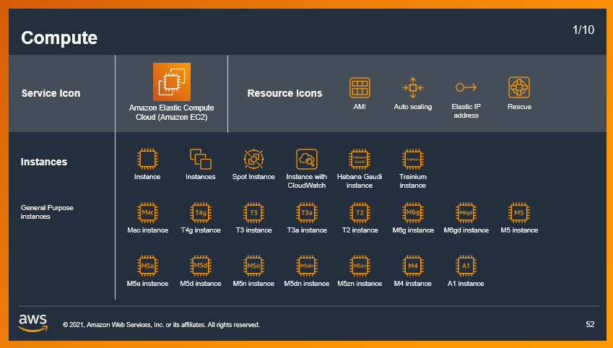
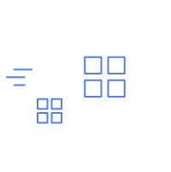
Icons, logos, diagrams, animations, and images
Only use logos, icons, photos, screenshots, and illustrations that your company has permission (a license) from the copyright owner to use.
Keep slide diagrams as simple as possible; split content over several slides rather than forcing it all onto one.
Use simple, subtle animations as needed to direct audience attention and clarify relationships. Avoid dramatic transitions or animations (such as “Random Bars,” “Dissolve,” or “Spin”).
Download AWS architecture icons from the AWS website
AWS speakers, download illustrations, icons, and AWS logos from the brand portal
AWS speakers, find licensed stock photography on Amazon Freeway or request access to Adobe Stock

